Slide 1
Michael Allen
What is Next: Sprint 4

Slide 2

The Anxieties of the Next Sprint
Data Manipulation Libraries / Packages
Data Manipulation Tools
As a Technology Teacher I Need to Understand How to Transfer My Excel Skills to R so that I can Build More Powerful Analysis on Top of What I Already Know

Slide 3
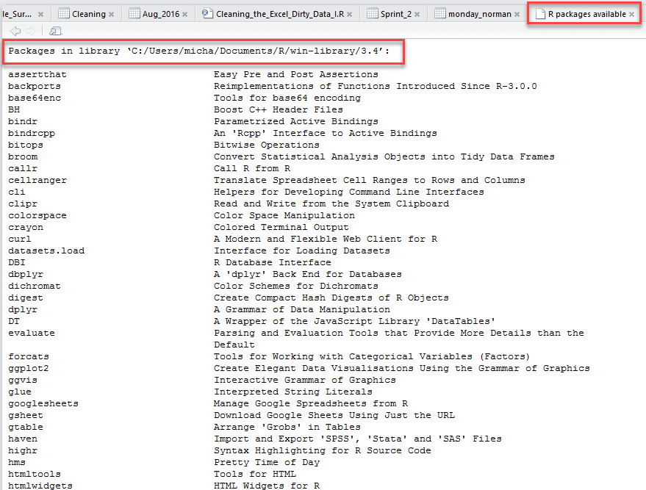
Package Versus Library
A package is a like a book, a library is like a library
You use library() to check a package out of the library
Good reminder of this difference is to run the function library() without arguments.
It will provide you the list of packages installed in different libraries on your computer.
A package is the collection of functions bundled conveniently

Slide 4
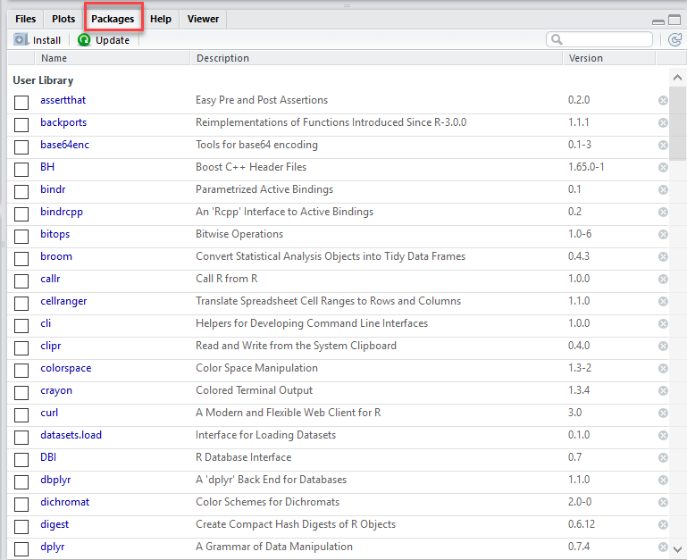
Another Way to View Your Packages
(Bottom Right Hand Side of R Studio)

Slide 5
Different Ways to Manipulate / Treat Data:
Beginners on R find themselves comfortable manipulating data using inbuilt base R functions. This is a good first step, but is often repetitive and time consuming. Hence, it is a less efficient way to solve the problem.
Use of packages for data manipulation. CRAN (Comprehensive R Archive Network) has over 10,000 packages available today. These packages are nothing but a collection of pre-written commonly used pieces of codes. They help you perform the repetitive tasks fasts, reduce errors in coding and take help of code written by experts (across the open source eco-system for R) to make your code more efficient. This is usually the most common way of performing data manipulation.

Slide 6
List of Packages (Libraries)
dplyr: It is known best for data exploration and transformation. It’s chaining syntax makes it highly adaptive to use. It includes 5 major data manipulation commands:
filter – It filters the data based on a condition
select – It is used to select columns of interest from a data set
arrange – It is used to arrange data set values on ascending or descending order
mutate – It is used to create new variables from existing variables
summarise (with group_by) – It is used to perform analysis by commonly used operations such as min, max, mean count etc
data.table: This package allows you to perform faster manipulation in a data set. Leave your traditional ways of sub setting rows and columns and use this package. With minimum coding, you can do much more. Using data.table helps in reducing computing time as compared to data.frame. You’ll be astonished by the simplicity of this package.

Slide 7
List of Packages (Libraries) II
ggplot2: Is a graphical package. It helps in visualizing data ( distributions, correlations) and making manipulations accordingly.
reshape2: This package is useful in reshaping data. We all know the data come in many forms. Hence, we are required to tame it according to our need. Usually, the process of reshaping data in R is tedious and worrisome. R base functions consist of ‘Aggregation’ option using which data can be reduced and rearranged into smaller forms, but with reduction in amount of information. Aggregation includes tapply, by and aggregate base functions. The reshape package overcome these problems. Here we try to combine features which have unique values. It has 2 functions namely melt and cast.
Lubridate: This package reduces the pain of working of data time variable in R. The inbuilt function of this package offers a nice way to make easy parsing in dates and times. This packages is frequently used with data comprising of timely data.

Slide 8
List of Packages (Libraries) III
readr: Helps in reading various forms of data into R. With 10x faster speed. Characters are never converted to factors(so no more stringAsFactors = FALSE). This package can replace the traditional read.csv() and read.table() base R functions. It helps in reading the following data:
Delimited files withread_delim(), read_csv(), read_tsv(), andread_csv2().
Fixed width files with read_fwf(), and read_table().
Web log files with read_log()
tidyr: This package can make your data look ‘tidy’. It has 4 major functions to accomplish this task. gather() – it ‘gathers’ multiple columns. Then, it converts them into key:value pairs. This function will transform wide from of data to long form. You can use it as in alternative to ‘melt’ in reshape package.
spread() – It does reverse of gather. It takes a key:value pair and converts it into separate columns.
separate() – It splits a column into multiple columns.
unite() – It does reverse of separate. It unites multiple columns into single column

Slide 9
What About Data Manipulation Tools
The Package dplyr Provides easy Tools for the Most Common Data Manipulation Tasks
It is Built to Work Directly with Data Frames
#bind the rows together - essentially read the three different datasets into one file
Total_MPLS_Mean_SD_Aug_2016 <- bind_rows(MPLS_Scores,Mean_Analysis_Aug_2016,SD_Analysis_Aug_2016)

Slide 10
Thank you

